Slide 1
Lesson 9 - Iterating Over An Object
Mr Mack 2019

Slide 2
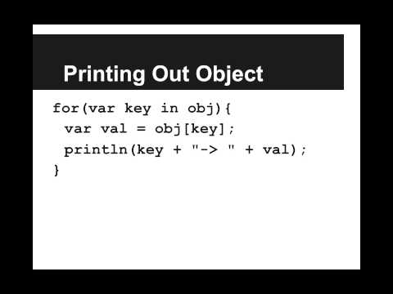
Iterating Over An Object

Slide 3
We have an object phonebook that holds all of our friends’ names associated with their phone numbers. How can we print out every name (key) and number (value) inside of phonebook?
println(phonebook);
phonebook.print();
for(var name in phonebook){
var number = phonebook[name];
println(name + " → " + number);
}
for(var number in phonebook){
var name = phonebook[number];
println(name + " → " + number);
}
none, there’s no way to iterate through every element in an object

Slide 4
Example: Print Phonebook
This is an example for this lesson. You are encouraged to play around with it, run and change the code, and learn how it works. When you are done, click continue to go to the next problem.

Slide 5
Exercise 5.9.1: Hogwarts
The Hogwarts sorting hat has had a busy day building up the studentHouse Object. Every student has been placed into a house: Gryffindor, Hufflepuff, Ravenclaw, or Slytherin. For example
println(studentHouse["Harry Potter"]);
Would print out
"Gryffindor"
Your job is to write a function printStudentsInHouse(studentHouse, house) that prints out the name of every student in the given house. For example, printStudentsInHouse(studentHouse, "Gryffindor") may print out
Gryffindor:
Harry Potter
Ron Weasley
Hermione Granger
Ginny Weasley
Peter Pettigrew

